Slide 1
VGA Web Graphics Ivo Pisařovic

Slide 2
Outline
Motivation to learn Javascript
Classic WebGL
A-Frame

Slide 3
PART 1
Motivation to learn Javascript
Motivation to learn Javascript
Classic WebGL
Three.js
A-Frame

Slide 4
"b" + "a" + + "a" + "a"
"baNaNa"
"" == false
true
0 == false
true
true + true + true
3
(![] + [])[+[]] +
(![] + [])[+!+[]] +
([![]] + [][[]])[+!+[] + [+[]]] +
(![] + [])[!+[] + !+[]];
"fail"
https://github.com/denysdovhan/wtfjs#true-is-false

Slide 5
So why do ANYthing in Javascript?

Slide 6
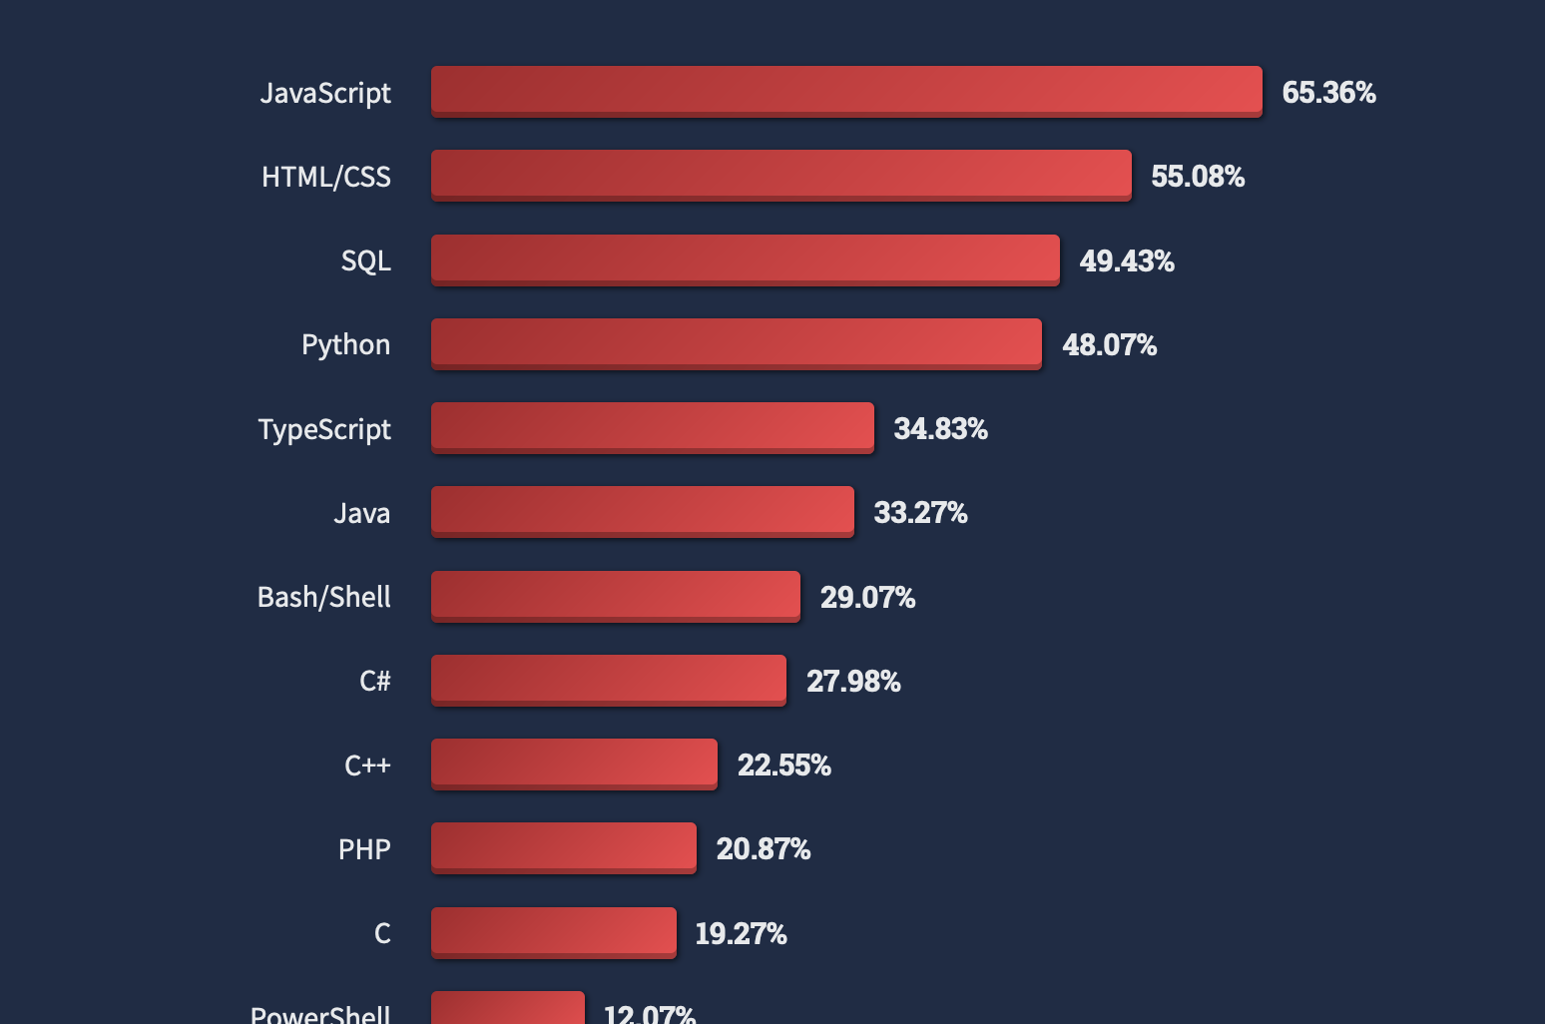
Language popularity = number of jobs
https://insights.stackoverflow.com/survey

Slide 7
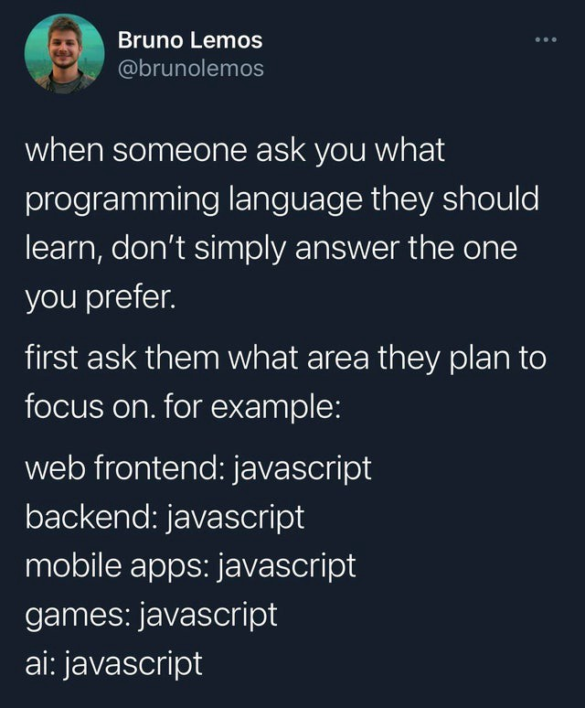
Cross-platform
One developer, one app, all platforms
Significant cost reduction
Monorepo approach (BE+FE together)
Web browser
Desktop (Windows, macOS, Linux, ...)
Mobile (Android, iOS)
Virtual Reality (HTC Vive, Oculus, ...)
Augmented reality (Microsoft HoloLens)
Machine learning (TensorFlow.js)

Slide 8

Modern syntax (ECMAScript standard)
Arrow functions Optional chaining Nullish coalescing Async/await, promises Typescript = stable development with the power of javascript
const visibleObjects = objects.filter(object => object.isVisible)
const sword = character?.inventory?.sword
character.name ?? "Unknown name"
async function downloadModel() { const response = await fetch('https://example.com/model.json') this.model = await response.json() }

Slide 9
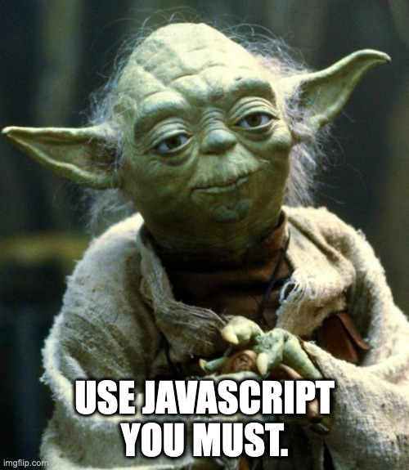

Slide 10
PART 2
Classic WebGL
Motivation to learn Javascript
Classic WebGL
Three.js
A-Frame

Slide 11
Ways to implement a 3D web app
Vanilla Javascript and WebGL
Medium-level libraries, e.g. Three.js, Babylon.js
High-level libraries, e.g. A-FRAME
3D software, e.g. Blender and export
Game Engines, e.g. Unity or Unreal Engine and export for web

Slide 12
WebGL
Javascript API for native graphic rendering in a web browser
Uses HTML element <canvas>
WebGL 1.0 based on OpenGL ES 2.0 (no fixed pipeline)
WebGL 2.0 based on OpenGL ES 3.0 (all browser supported)
WebGPU
New, more efficient technology
Based on modern graphic APIs (Vulkan, Metal, Direct3D)
Advanced shading and ray tracing, new GPU compute shaders
Chrome, Edge supported; Safari, Firefox, etc. not supported yet!

Slide 13
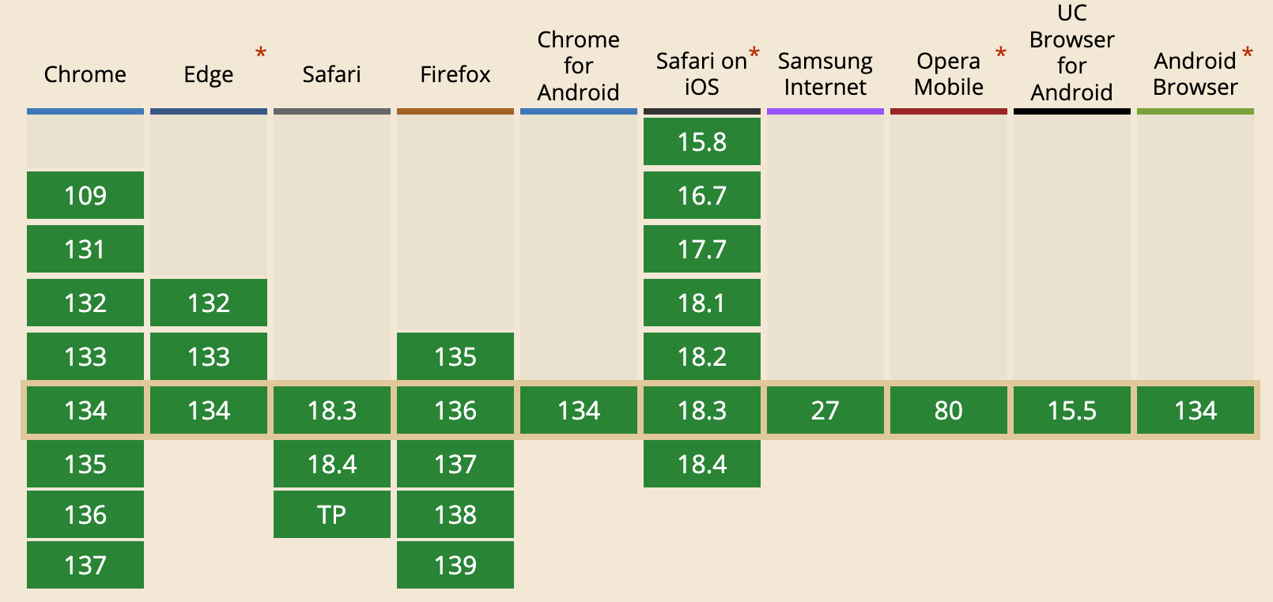
Support of WebGL in web browsers
https://caniuse.com/?search=webgl

Slide 14
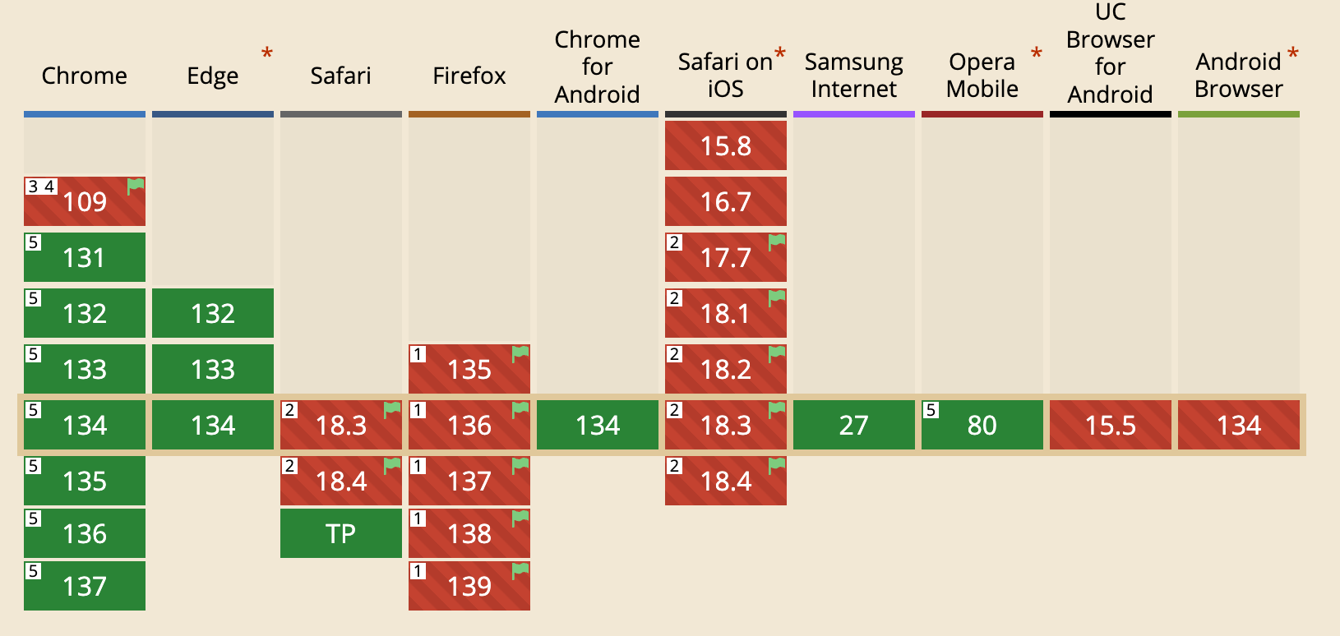
Support of WebGPU in web browsers
https://caniuse.com/?search=webgpu

Slide 15
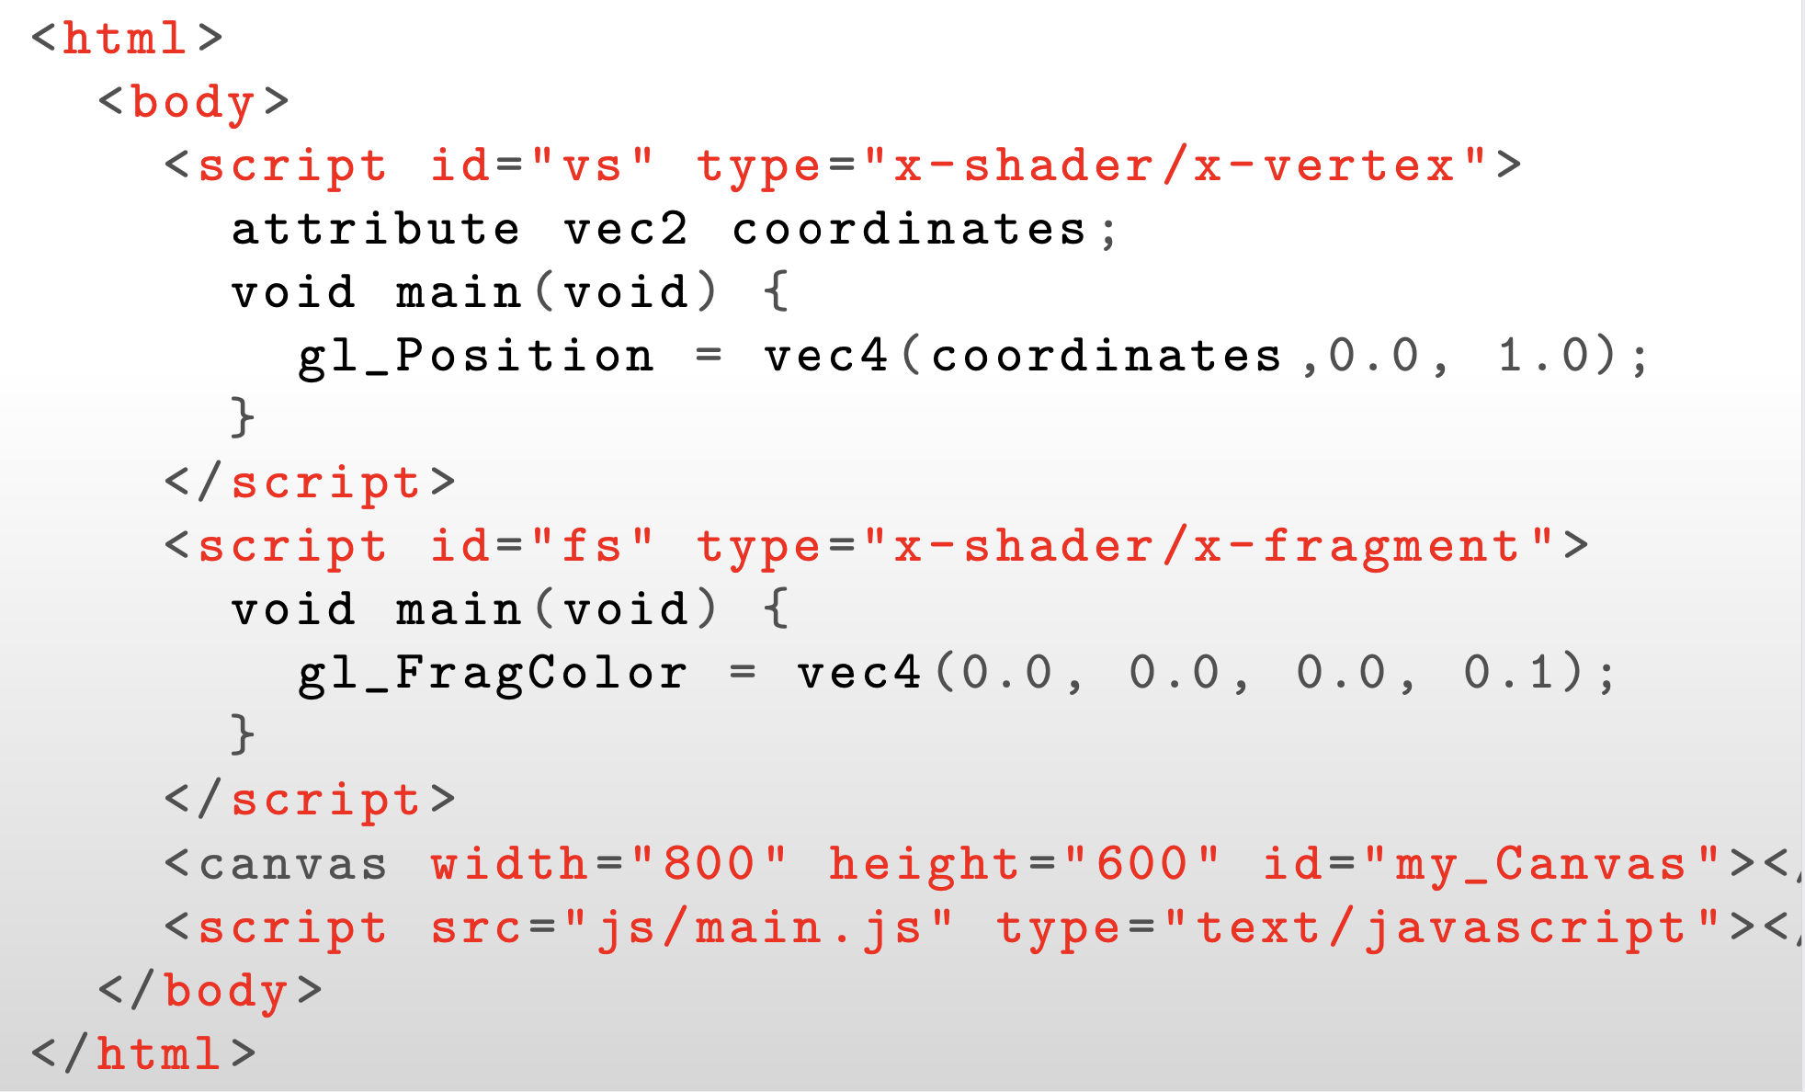
Pure WebGL example: HTML part

Slide 16
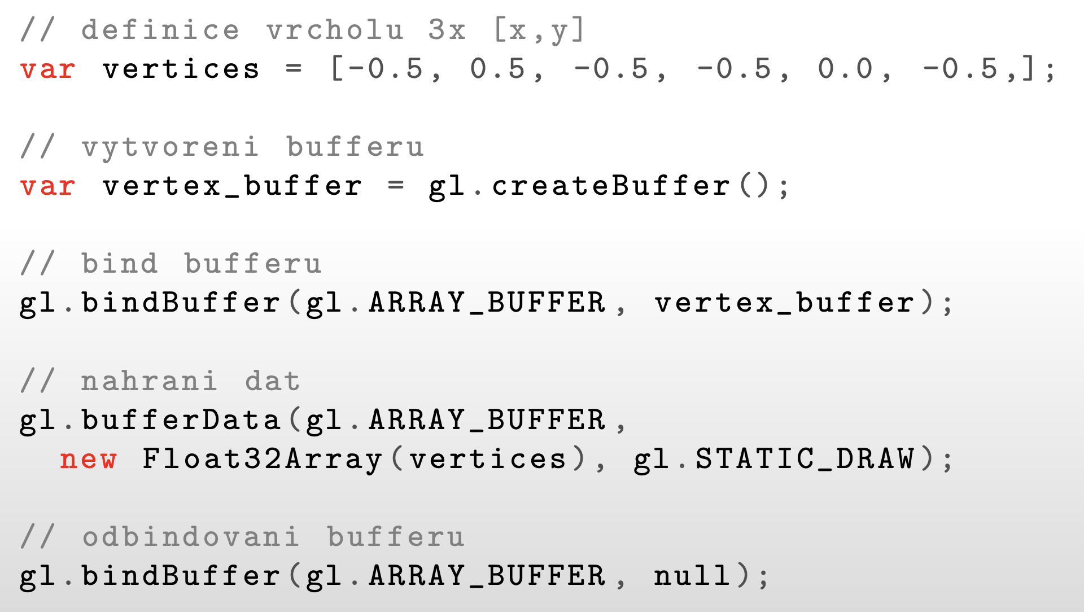
Pure WebGL example: buffers

Slide 17


Slide 18
PART 2
Three.js
Motivation to learn Javascript
Classic WebGL
Three.js
A-Frame

Slide 19
Three.js
Middle-level wrapper over WebGL
Common things are ready-to-use objects (cubes, lights, camera, …).
Imperative OOP syntax
Example of creating a 3D box with the given size and color:
const geometry = new THREE.BoxGeometry( 1, 1, 1 ); const material = new THREE.MeshBasicMaterial( { color: 0x00ff00 } ); const cube = new THREE.Mesh( geometry, material ); scene.add( cube ); cube.position.z = 5;
cube.rotation.y = Math.PI / 2;

Slide 20
Three.js
Example of loading a model and adding it to the scene:
// Instantiate a loader const loader = new GLTFLoader(); // Load a glTF resource loader.load( 'models/gltf/duck/duck.gltf', function (gltf) { // called when the resource is loaded scene.add(gltf.scene); // gltf may contains also camera, lights,...
gltf.scene.position.set(3, -4, 5); }, function (xhr) { // called while loading is progressing console.log((xhr.loaded / xhr.total * 100) + '% loaded'); }, function (error) { // called when loading has errors console.log('An error happened'); } );

Slide 21
PART 3
A-Frame
Motivation to learn Javascript
Classic WebGL
Three.js
A-Frame

Slide 22
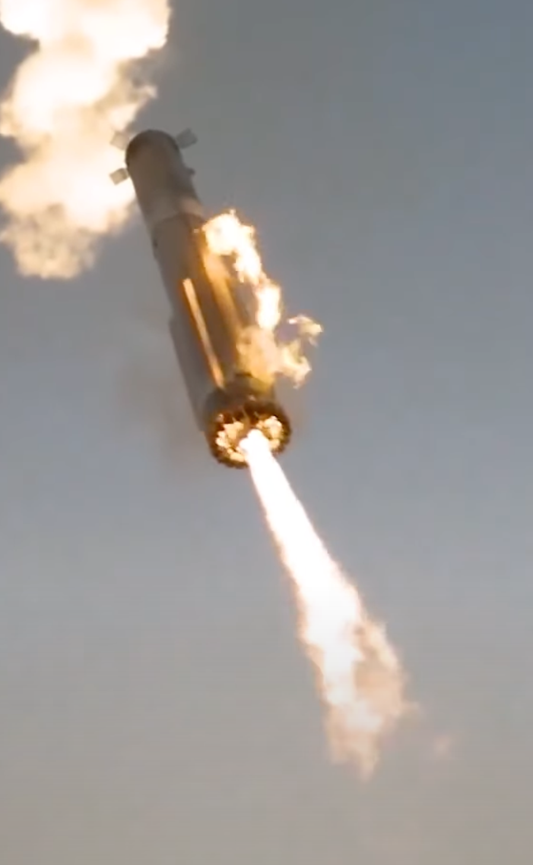
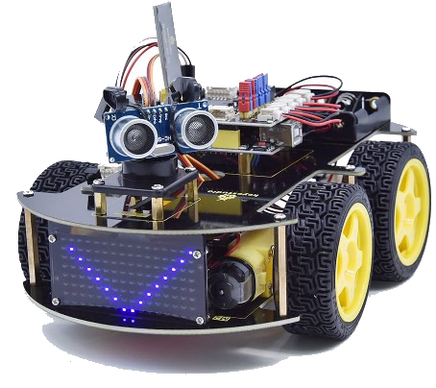
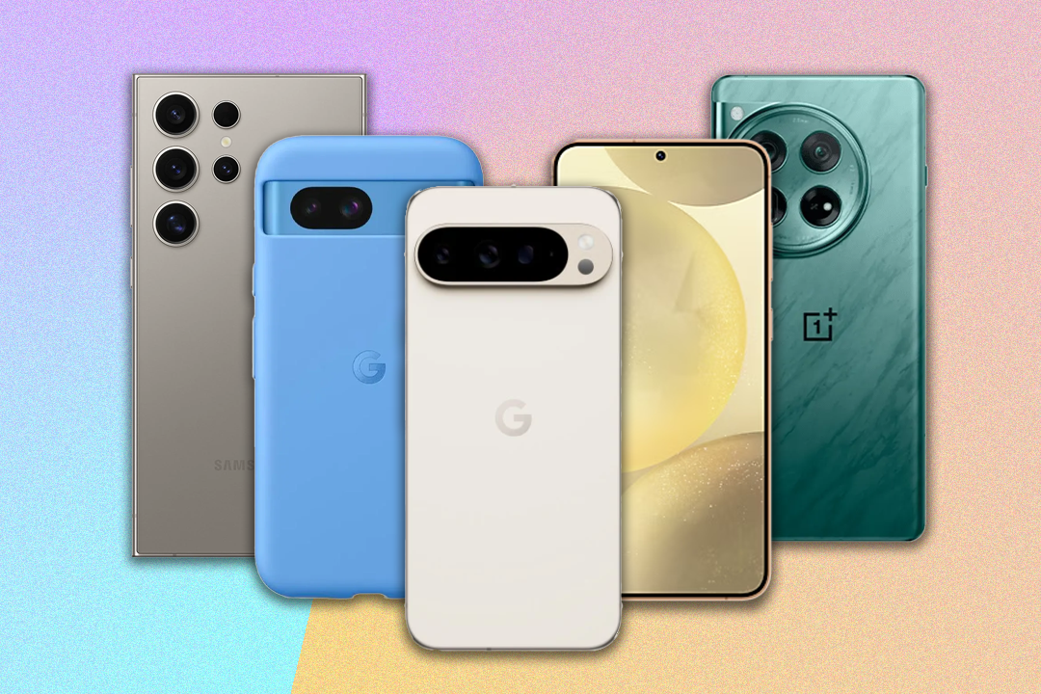
What are the key factors of innovations?
Did you know that the light bulb was developed independently by several scientists? Edison was about 10-20th in order. Why didn't the first light bulb become famous?
The technology must be cheap and accessible for everyone to try. One must establish an environment that doesn't inhibit experimentation.

Slide 23

How to accelerate innovations in 3D development?
Build on a technology that everyone knows.
HTML a open-source webové technologie
Enable to run everywhere.
Podpora různých AR helem a hlavně mobilů
No need of special expensive hardware.
Možnost vyvíjet zdarma na jakémkoliv počítači

Slide 24
A-FRAME
High-level wrapper over Three.js
Zero-code support for VR and AR
Component architecture
Cross-platform (web, mobile, Meta Quest, HTC Vive, Microsoft Holo Lens)
Declarative syntax (using HTML to define scene)
<a-scene> <a-box position="-1 0.5 -3" rotation="0 45 0" color="#4CC3D9"></a-box> <a-sphere position="0 1.25 -5" radius="1.25" color="#EF2D5E"></a-sphere> <a-cylinder position="1 0.75 -3" radius=”2" height=”3" color="#FFC65D"></a-cylinder> <a-plane position="0 0 -4" rotation="-90 0 0" width="4" height="4”></a-plane> <a-sky color="#ECECEC"></a-sky> </a-scene>

Slide 25
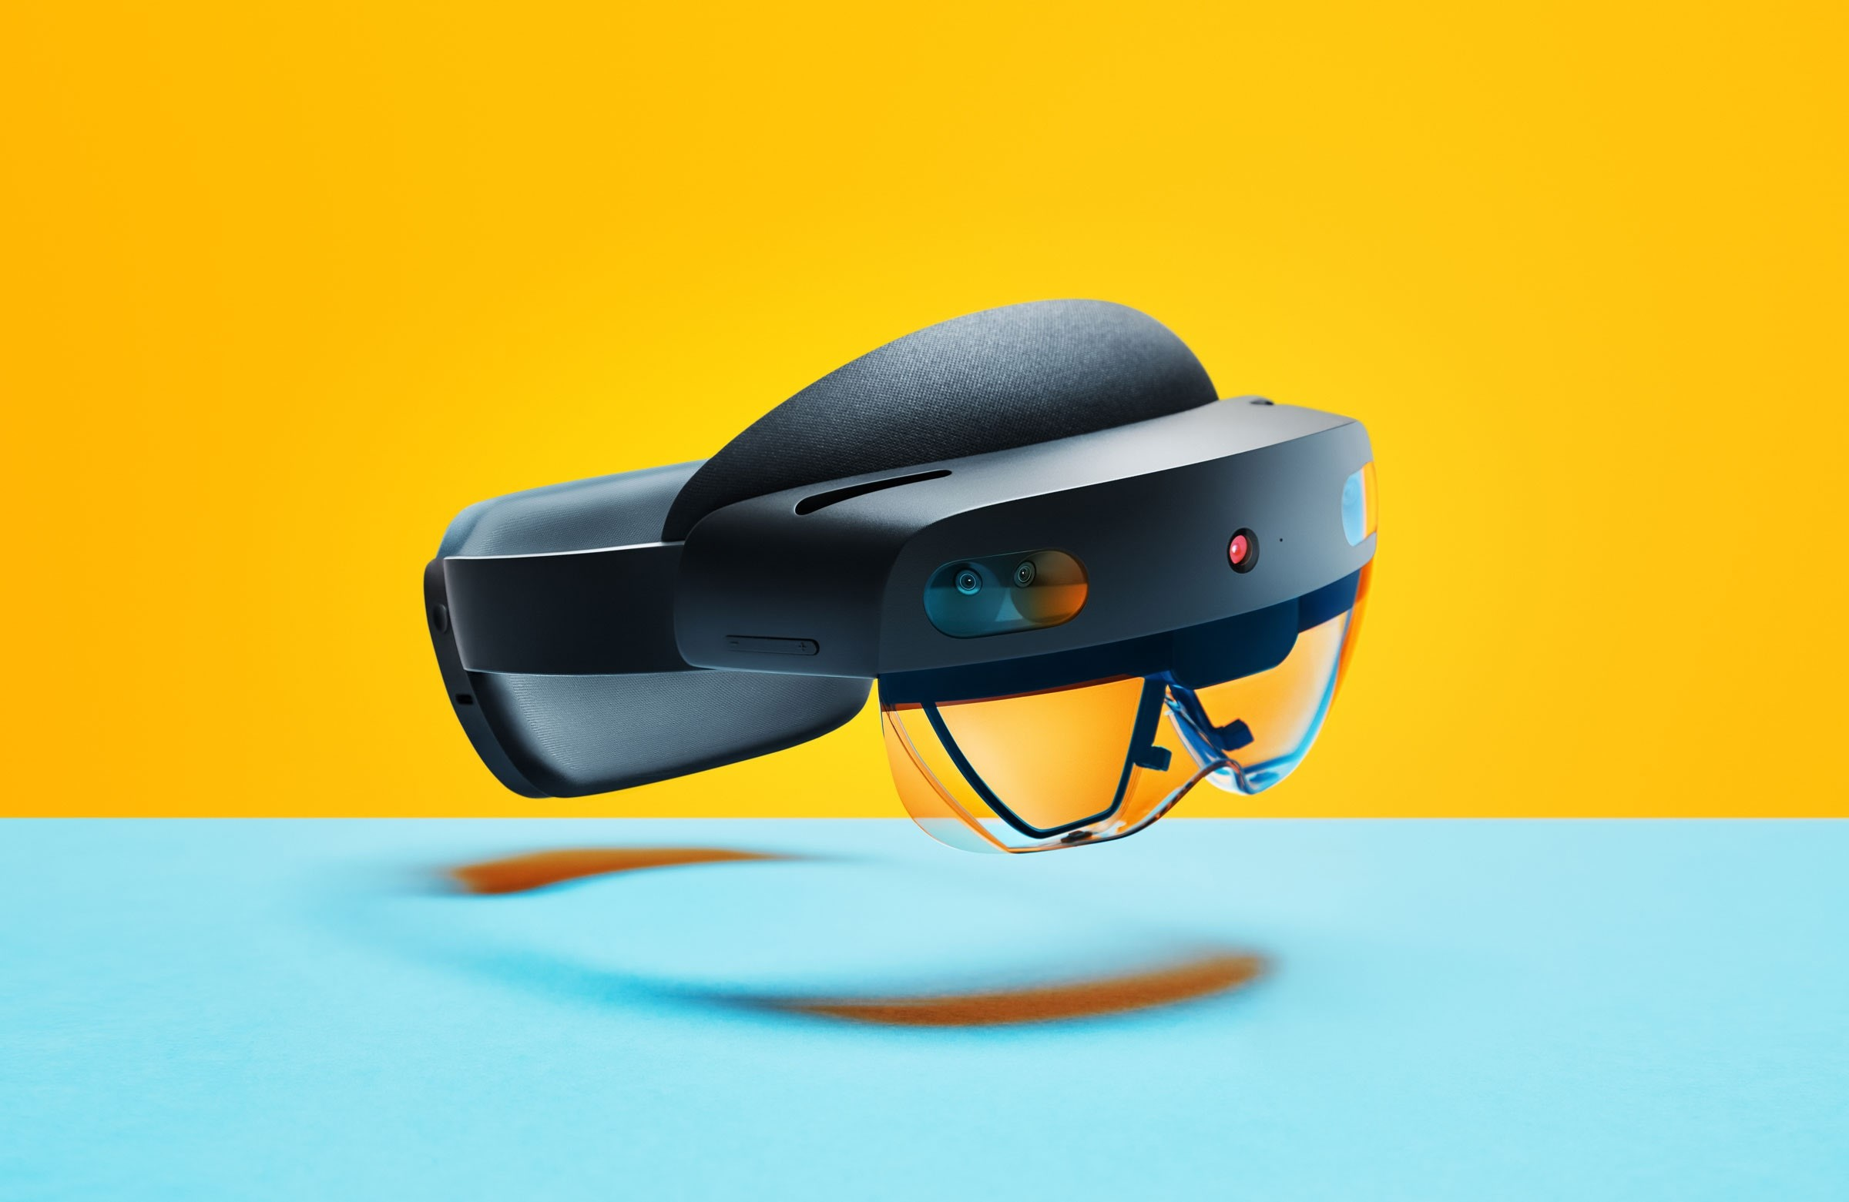
A-FRAME Device Support
HTC Vive Pro
Meta Quest 3
Meta Quest Pro
Microsoft HoloLens 2
iPhone Pro
iPad Pro
...

Slide 26







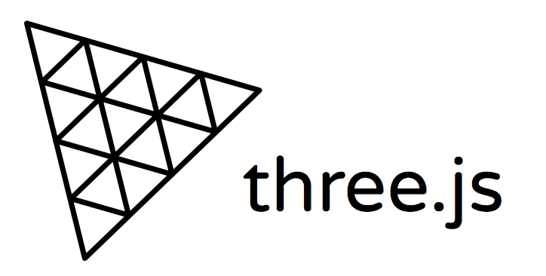




A-FRAME Architecture
A-Frame
https://game.play
GPU

Slide 27
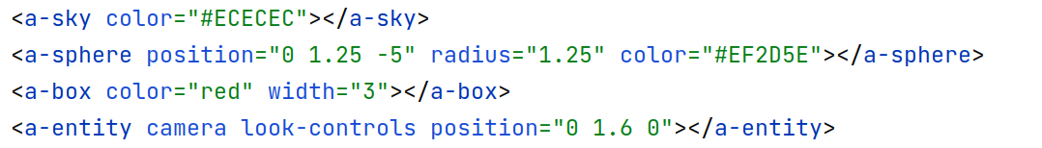
A-FRAME Entities
Everything is a general entity:
Syntactic helpers for common objects = primitives:

Slide 28
A-FRAME Components
Entity-component-system instead of inheritance and hierarchy (OOP, three.js)
Common in game and VR/AR development
More suitable than OOP because there are many objects that must interact with each other. Using OOP would lead to a dependency hell.
A set of reusable encapsulated modules attached to entities
System
<a-scene>
Entity <a-entity>
Entity <a-entity>
Component
material=”color: red”
Component
grab
Component
grab
Component
physics=”mass: 0.78”
Component
oculus-touch-controls
Component
material=”color: red”

Slide 29
A-FRAME Components
Entity
Component’s properties
property: value;
Component’s properties
property: value;
Component
Component

Slide 30
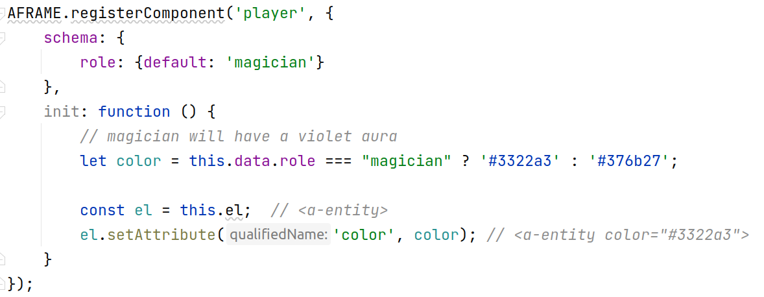
A-FRAME Component Example

Slide 31
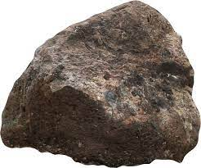

A-FRAME Events
Component: gltf-model
<a-entity gltf-model="baby-yoda.gltf" have-force ></a-entity>
Component: have-force
Component: gltf-model
<a-entity gltf-model="rock.gltf” ></a-entity>
emit('force-event')
Component ”have-force” attached to entity baby-yoda just emited an event “force-event” that will be caught by the rock, causing it to fly.

Slide 32
Comparison of approaches to rendering content
Imperative approach
Reactive approach
Event based system
Function-based
Manual UI updates through method calls
Vanilla JS, WebGL, Three.js
Data-driven
UI updates automatically based on changes in data
Vue, React, Qt
Event-based
Emiting events to trigger an update
A-FRAME
For nerds:
It is very beneficial to combine Vue or React with A-FRAME and reactively update 3D scene 😍

Slide 33
Summary of Web Graphics
Pros:
Cons:
Quick development & prototyping
Cross-platform by design
Large community
Open technologies
Easily distributed to users via a URL
Everything must be dowloaded when the user load the page => low quality models
Less performance (although WebGPU instead brings improvements over WebGL)
Absence of complex game engines, more things you must create from scratch

Slide 34

Ukázky z praxe
Notes:
https://henryegloff.com/examples-of-browser-based-games-using-three-js-javascript-and-webgl/

Slide 35

Interland
Online safety by Google
Notes:
https://henryegloff.com/examples-of-browser-based-games-using-three-js-javascript-and-webgl/

Slide 36
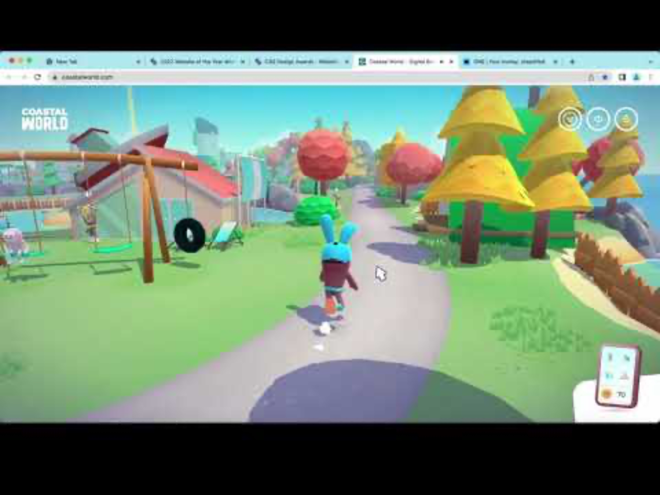
Coastal World
Finance education
Notes:
https://henryegloff.com/examples-of-browser-based-games-using-three-js-javascript-and-webgl/

Slide 37
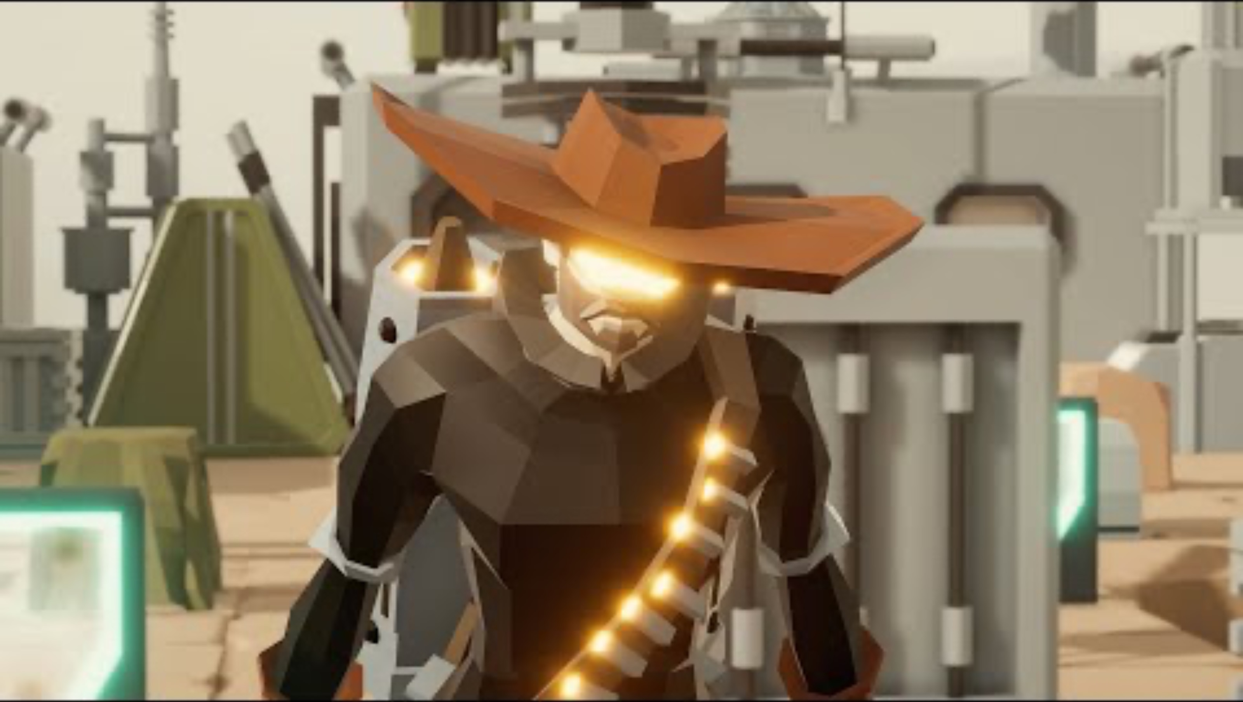
Scavenger Land
Tactical battle with NFTs

Slide 38
Q&A

Slide 39


